Slide 1
LIST

Slide 2
What is a List
This Generic List<T> Collection Class represents a strongly typed list of objects which can be accessed by using the integer index which is starting from 0.
The size of the collection grows automatically when we add items to the collection.
Creating a List
To create a list you need to specify the datatype of the elements the list will hold

Slide 3
Adding an Item to a List
Add(T item): The Add(T item) method is used to add an element to the end of the Generic List. Here, the parameter item specifies the object to be added to the end of the Generic List. The value can be null for a reference type.
AddRange(IEnumerable<T> collection): The AddRange(IEnumerable<T> collection) method is used to add the Elements of the specified collection to the end of the Generic List. The parameter collection specifies the collection whose elements should be added to the end of the Generic List. The collection itself cannot be null, but it can contain elements that are null if type T is a reference type.

Slide 4
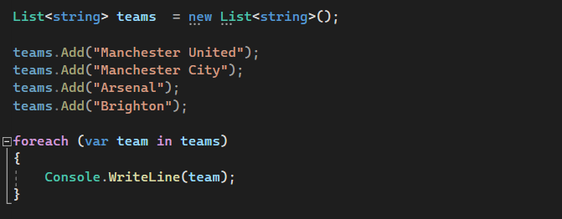

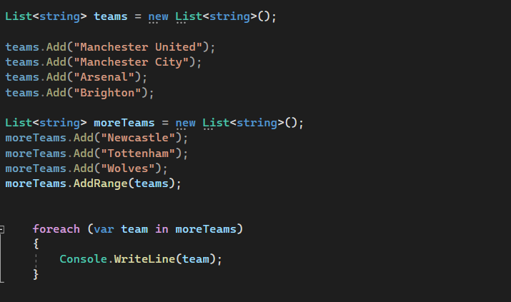


Slide 5
Accessing Elements in a List
Using Index to Access Generic List<T>
The List<T> Class Implements the IList<T> interface. So, we can access the individual elements of the List Collection in C# by using the integral index. In this case, we just need to specify the index position of the element that we want to access. The Index is 0 Based. If the specified index is not present, then the compiler will throw an exception.
Using For-Each Loop to Access Generic List<T>
You can also use a for-each loop to access the elements of a Generic List<T> collection
Using For Loop to Access Generic List<T>
You can also access the Generic List<T> collection in C# using a for loop as follows. Here, we need to get the count of the list collection by using the Count properties of the List class and then start the loop from 0 and fetch the element of the list collection using the Index position.

Slide 6
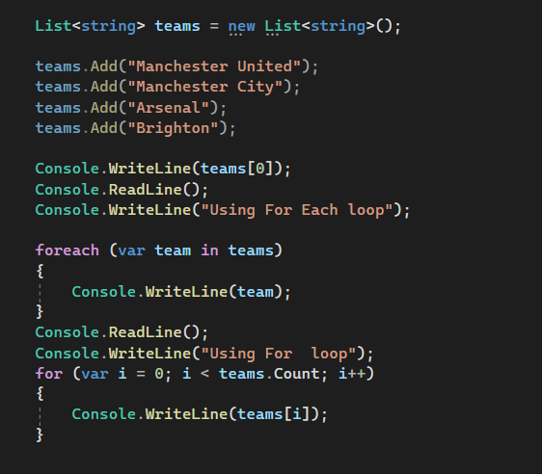
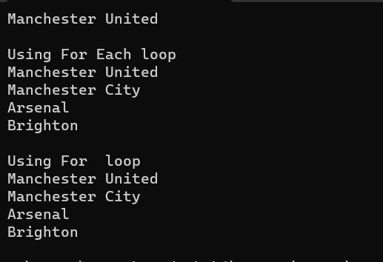

Slide 7
How to Insert Elements at a Specific Position in a Generic List Collection
If you want to Insert a specific Element or a collection of Elements at a specific position in a Generic List Collection, then you need to use the following two methods provided by the Generic List Collection Class in C#. The Insert method is used to insert a specific element and the InsertRange method is used to insert a collection of elements.
Insert(int index, T item): This method is used to insert an element into the Generic List at the specified index. Here, the parameter index specifies the zero-based index at which an item should be inserted and the parameter item specifies the object to insert. The value can be null for reference types. If the index is less than 0 or the index is greater than Generic List Count, then it will throw ArgumentOutOfRangeException.
InsertRange(int index, IEnumerable<T> collection): This method is used to insert the elements of a collection into the Generic List at the specified index. Here, the parameter index specifies the zero-based index at which an item should be inserted. The parameter collection specifies the collection whose elements should be inserted into the Generic List. The collection itself cannot be null, but it can contain elements that are null if type T is a reference type. If the collection is null, then it will throw ArgumentNullException. If the index is less than 0 or the index is greater than Generic List Count, then it will throw ArgumentOutOfRangeException.

Slide 8
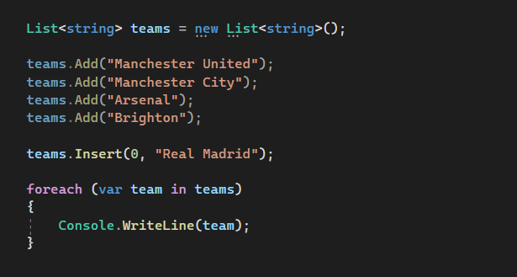

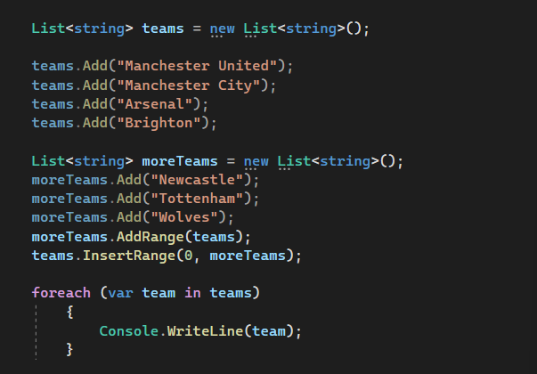
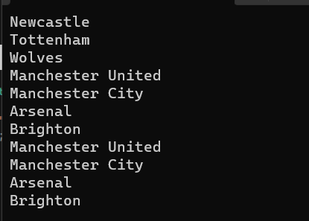

Slide 9
How to Check the Availability of an Element in a List Collection
If you want to check whether an element exists or not in the Generic List Collection, then you need to use the following Contains method of the Generic List Collection Class in C#.
Contains(T item): The Contains(T item) method of the Generic List Collection Class is used to check if the given item is present in the List or not. The parameter item specifies the object to locate in the Generic List. The value can be null for reference types. It returns true if the item is found in the Generic List; otherwise, false.

Slide 10
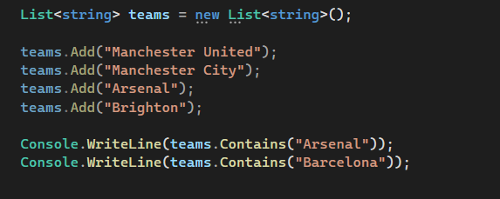


Slide 11
How to Remove Elements from a Generic List Collection
If you want to remove elements from the list, then you can use the following methods of the List collection class.
Remove(T item): This method is used to remove the first occurrence of a specific object from the Generic List. Here, the parameter item specifies the object to remove from the Generic List. It returns true if the item is successfully removed; otherwise, false. This method also returns false if the item was not found in the Generic List.
RemoveAll(Predicate<T> match): This method is used to remove all the elements that match the conditions defined by the specified predicate. Here, the parameter match specifies the predicate delegate that defines the conditions of the elements to remove. It returns the number of elements removed from the Generic List. If the parameter match is null, then it will throw ArgumentNullException.
RemoveAt(int index): This method is used to remove the element at the specified index of the Generic List. Here, the parameter index is the zero-based index of the element to remove. If the index is less than 0 or the index is equal to or greater than Generic List Count, then it will throw ArgumentOutOfRangeException.
RemoveRange(int index, int count): This method is used to remove a range of elements from the Generic List. Here, the parameter index is the zero-based starting index of the range of elements to remove and the parameter count is the number of elements to remove. If the index is less than 0 or the count is less than 0, then it will throw ArgumentOutOfRangeException. If the index and count do not denote a valid range of elements in the Generic List, then it will throw ArgumentException.
Clear(): This method is used to remove all elements from the Generic List.

Slide 12
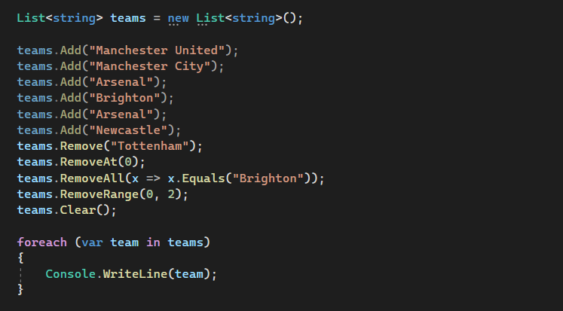

Slide 13
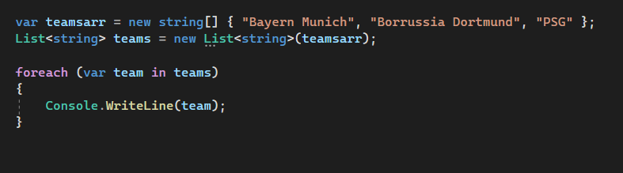

How to Copy an Array to a List
To Copy an Array to a List we need to use the following overloaded constructor of the List class in C#. As you
public List(IEnumerable<T> collection): This constructor is used to initialize a new instance of the Generic List class that contains elements copied from the specified collection and has sufficient capacity to accommodate the number of elements copied. The parameter collection specifies the collection whose elements are copied to the new list

Slide 14
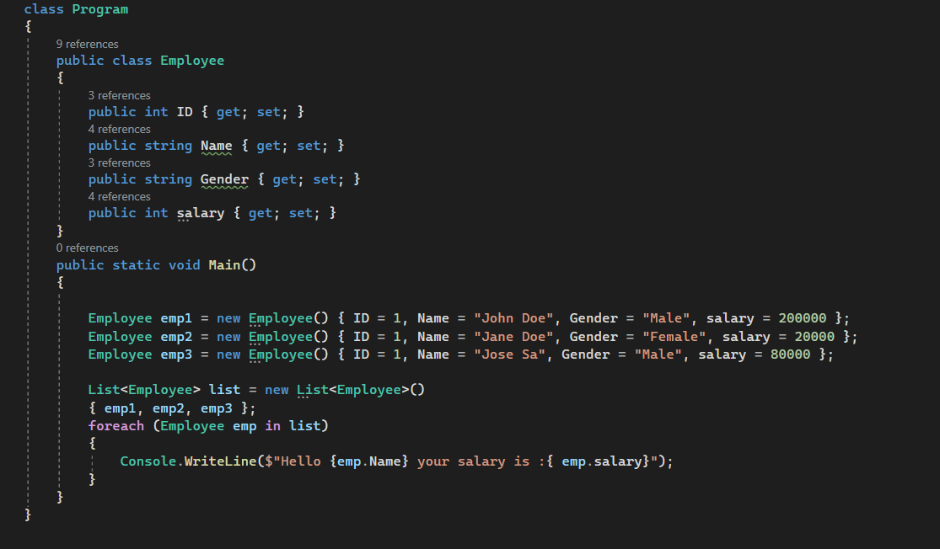


Slide 15
How to Find Element in a Generic List Collection
The Generic List Collection Class in C# provides a lot of useful methods that we can use to find elements on a collection of List Types. The List Collection class provides the following important methods to find elements in a collection.
Find(): The Find() method is used to find the first element from a list based on a condition that is specified by a lambda expression.
FindLast(): The FindLast() method is used to search for an element that matches the conditions specified by a predicate. If it found any elements with that specified condition then it returns the Last matching element from the list.
FindAll(): The FindAll() method is used to retrieve all the elements from a list that matches the conditions specified by a predicate.
FindIndex(): The FindIndex() method is used to return the index position of the first element that matches the conditions specified by a predicate. The point that you need to remember is the index here in generic collections is zero-based. This method returns -1 if an element that matches the specified conditions is not found. There are 2 other overloaded versions of this method is available, one of the overload versions allows us to specify the range of elements to search within the list.
FindLastIndex(): The FindLastIndex() Method searches for an element in the list that matches the condition specified by the lambda expression and then returns the index of the last occurrence of the item within the list. There are 2 other overloaded versions of this method is available, one of the overload versions allows us to specify the range of elements to search within the list.
Exists(): The Exists() method is used to check or determine whether an item exists or not in a list based on a condition. If the item exists then it will return true else it will return false.
Contains(): The Contains() method is used to determine whether the specified item exists or not in the list. If the specified item exists then it will return true else return false.

Slide 16
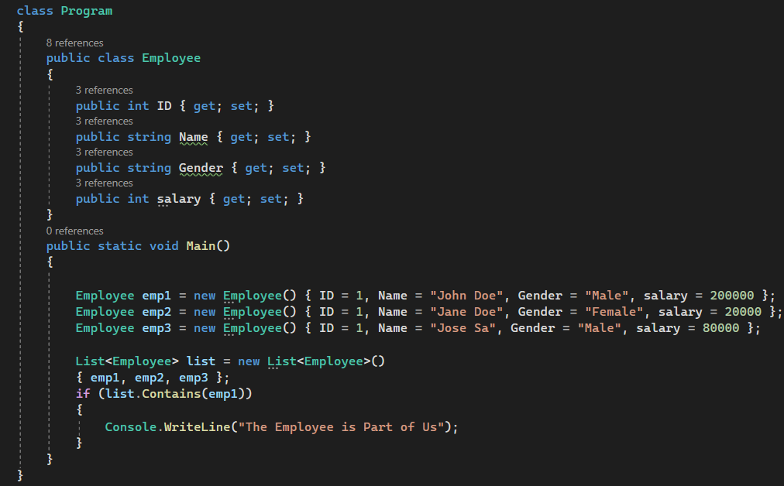


Slide 17
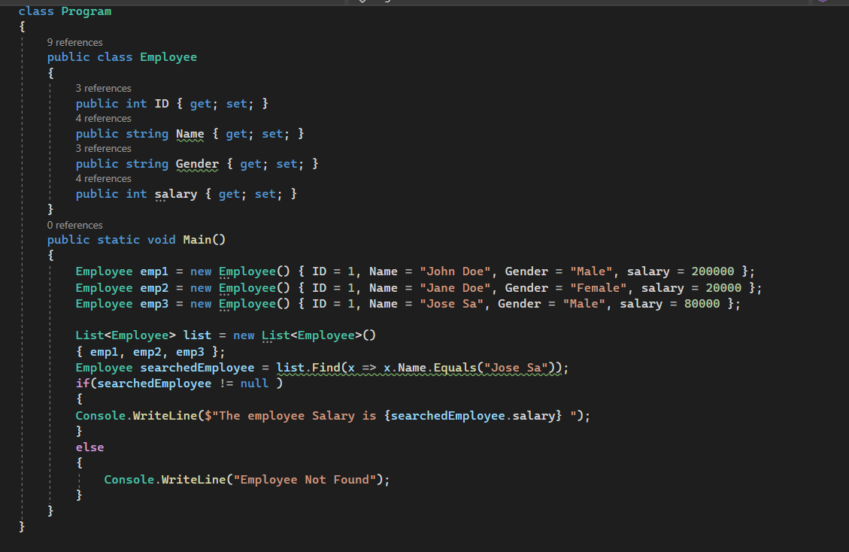


Slide 18
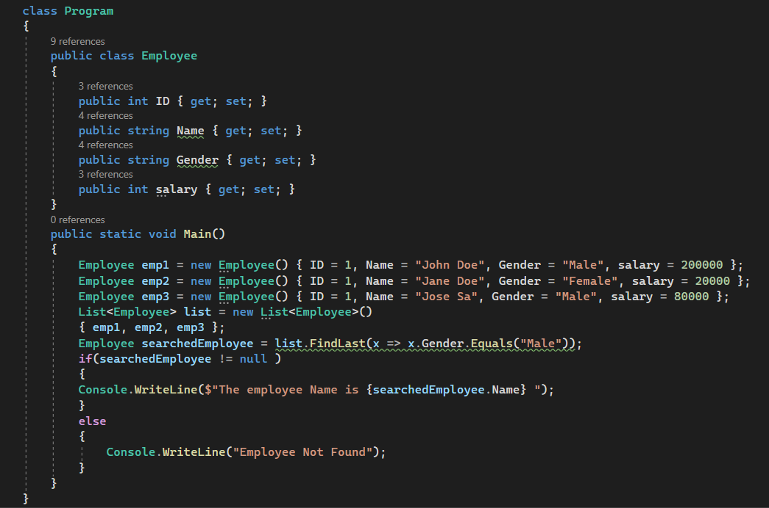


Slide 19
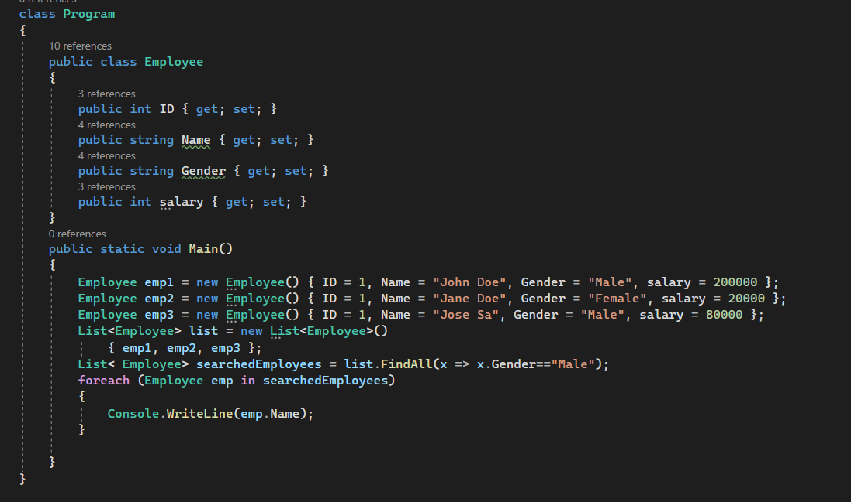


Slide 20
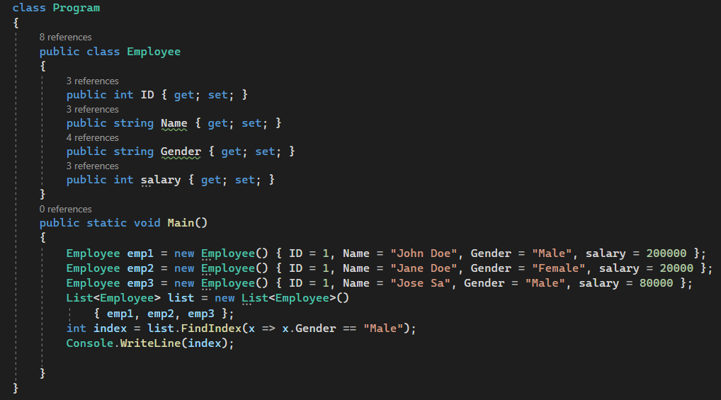


Slide 21
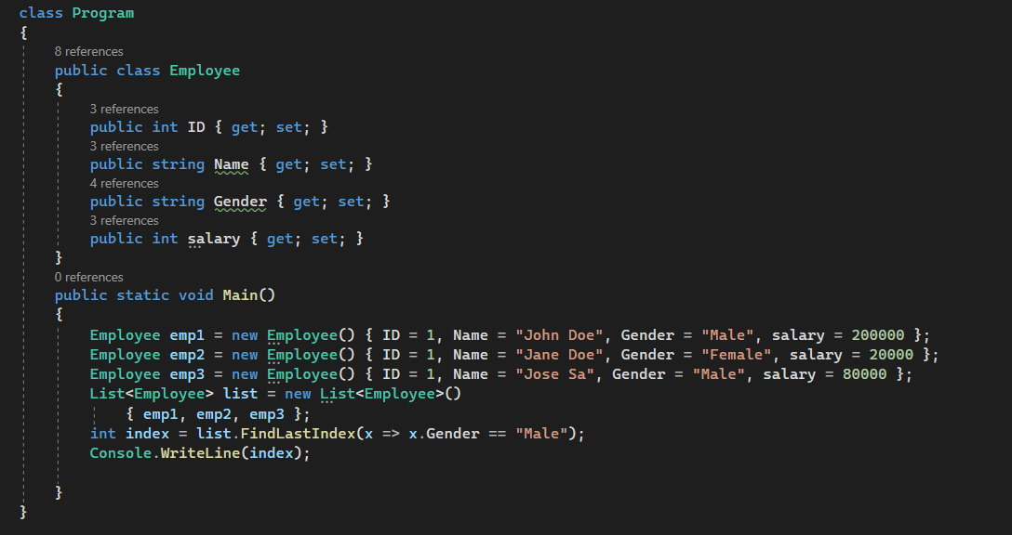


Slide 22
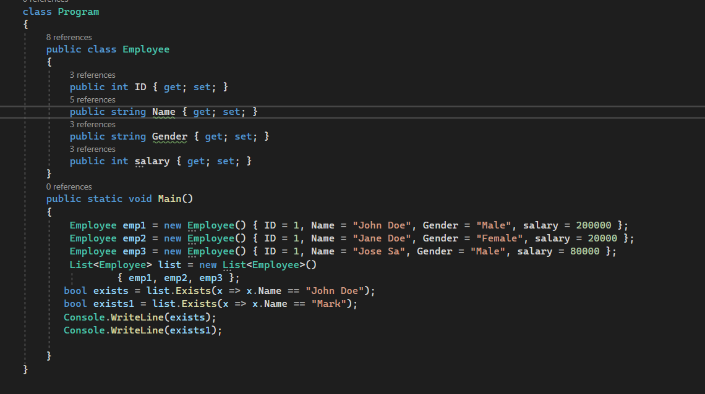


Slide 23
Other Methods
TrueForAll(): This method returns true or false depending on whether every element in the list matches the conditions defined by the specified predicate.
AsReadOnly(): This method returns a read-only wrapper for the current collection. Use this method, if you don’t want the client to modify the collection i.e. add or remove any elements from the collection. The ReadOnlyCollection will not have methods to add or remove items from the collection. We can only read items from this collection.
TrimExcess(): This method sets the capacity to the actual number of elements in the List if that number is less than a threshold value.

Slide 24
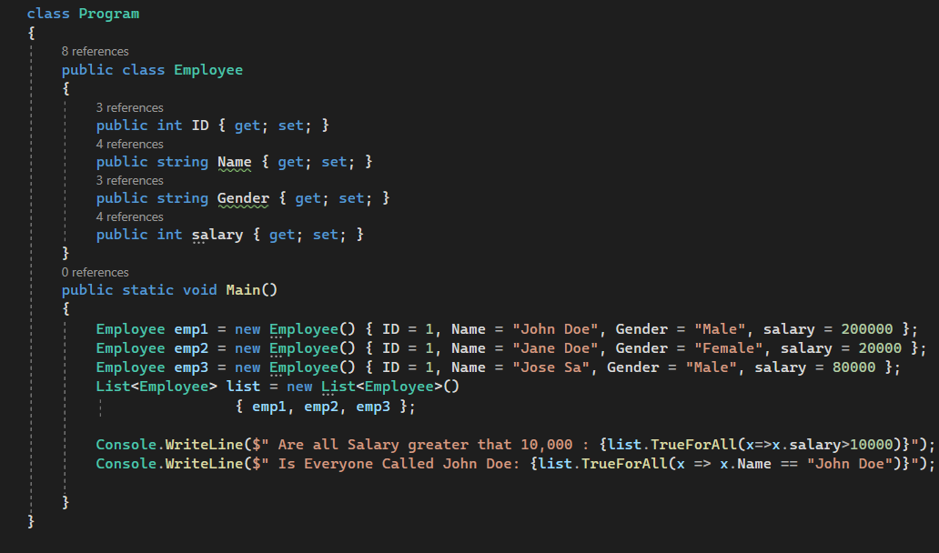


Slide 25
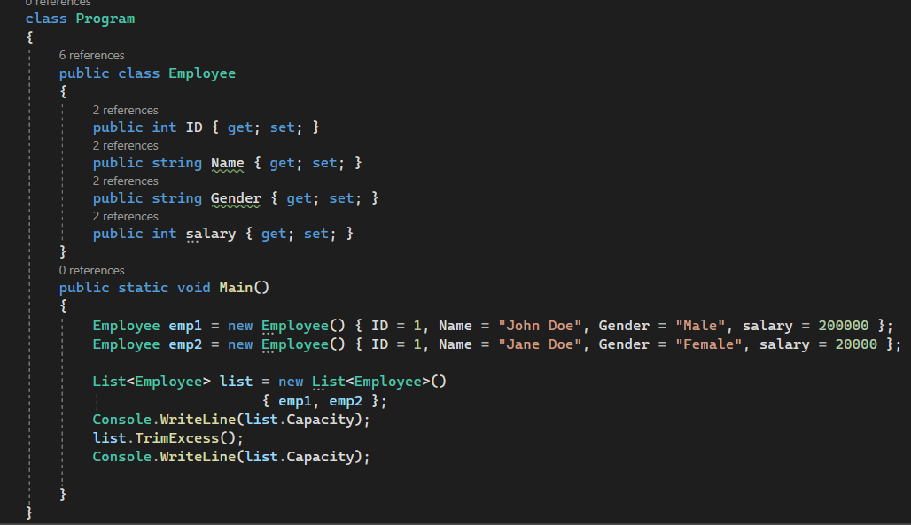


Slide 26
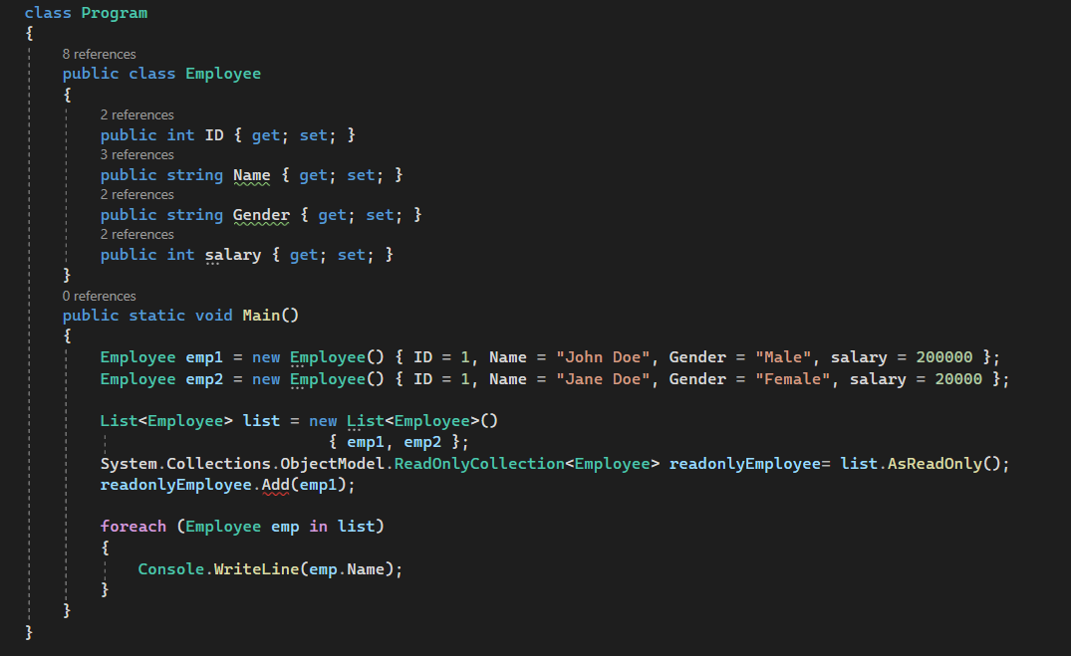

Slide 27
Sort
In C#, sorting a list of simple types like int, double, char, string, etc. is straightforward. Here, we just need to call the Sort() method which is provided by the Generic List class on the list instance, and then the data will be automatically sorted in ascending order.
If you want the data to be retrieved in descending order, then use the Reverse() method on the list instance.
However complex sorting e.g. sorting by name in a Employee list is not possible with the sort method.

Slide 28
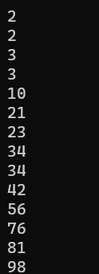
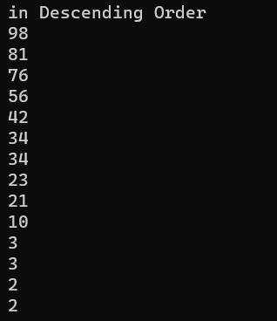
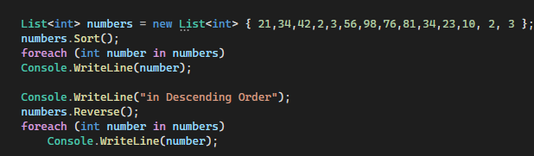

Slide 29
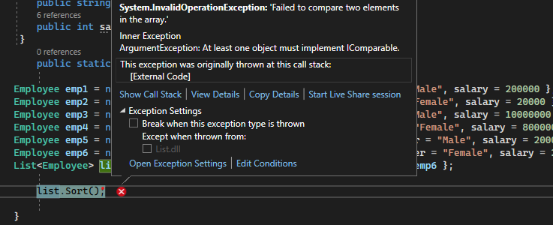
How the sort functionality is working for simple data types like int, double, string, char, etc.
This is because these datatypes are implementing the IComparable interfaces e.g.

Slide 30
How to Sort a complex List e.g a List of Employees
Sort(): This method is used to sort the elements in the entire Generic List using the default comparer.
Sort(IComparer<T> comparer): This method is used to sort the elements in the entire Generic List using the specified comparer.
Sort(Comparison<T> comparison): This method is used to sort the elements in the entire Generic List using the specified System.Comparison.
Sort(int index, int count, IComparer<T> comparer): This method is used to sort the elements in a range of elements in a Generic List using the specified comparer.

Slide 31
How to Sort a List of Complex Types
To sort a list of complex types without using LINQ, the complex type has to implement the IComparable interface and needs to provide the implementation for the CompareTo() method as follows. The CompareTo() method returns an integer value and the meaning of the return value as shown below.
Return value greater than ZERO – The current instance is greater than the object being compared with.
Return value less than ZERO – The current instance is less than the object being compared with.
The Return value is ZERO – The current instance is equal to the object being compared with.
Alternatively, we can also invoke the CompareTo() method directly. The Salary property of the Employee object is int and the CompareTo() method is already implemented on the integer type that we already discussed, so we can invoke this method and return its value as shown below.
return this.Salary.CompareTo(obj.Salary);

Slide 32
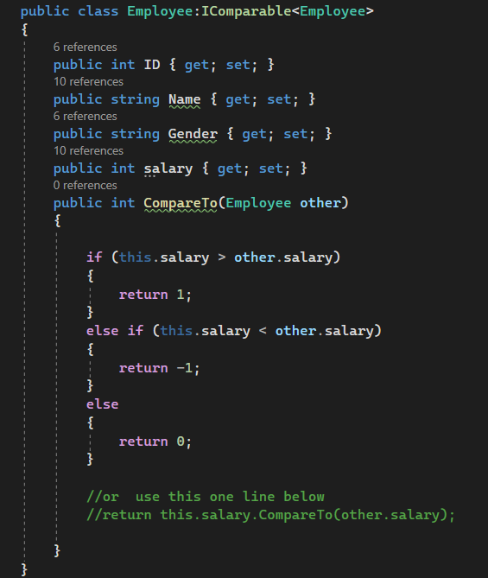
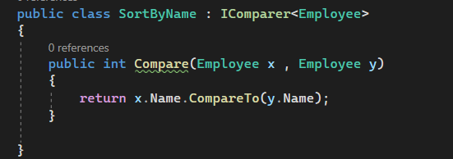

Implementing the IComparable interface

Slide 33
Comparison Delegate
Sort(): This method is used to sort the elements in the entire Generic List using the default comparer.
Sort(IComparer<T> comparer): This method is used to sort the elements in the entire Generic List using the specified comparer.
Sort(Comparison<T> comparison): This method is used to sort the elements in the entire Generic List using the specified System.Comparison.
Sort(int index, int count, IComparer<T> comparer): This method is used to sort the elements in a range of elements in a Generic List using the specified comparer.
Sort(Comparison<T> comparison) method in the List class, expects the Comparison delegate to be passed as an argument. We know what is a Delegate. A delegate is a function pointer and when we invoke the delegate, the function it points to is going to be executed. So, we need to create one method whose signature must be matched with the signature of the Comparison delegate and then we need to create an instance of the Comparison delegate and to the constructor of the Comparison delegate, we need to pass the method name which we want to execute.

Slide 34
What is Comparison<T> Delegate
The Comparison Delegate represents the method that compares two objects of the same type. Here, the parameter x is the first object to compare. The parameter y is the second object to compare. And here T represents the type of objects to be compared. It returns a signed integer that indicates the relative values of x and y, as shown in the following table.
Return value greater than ZERO – x is greater than y.
Return value less than ZERO – x is less than y
The Return value is ZERO – x equals y

Slide 35
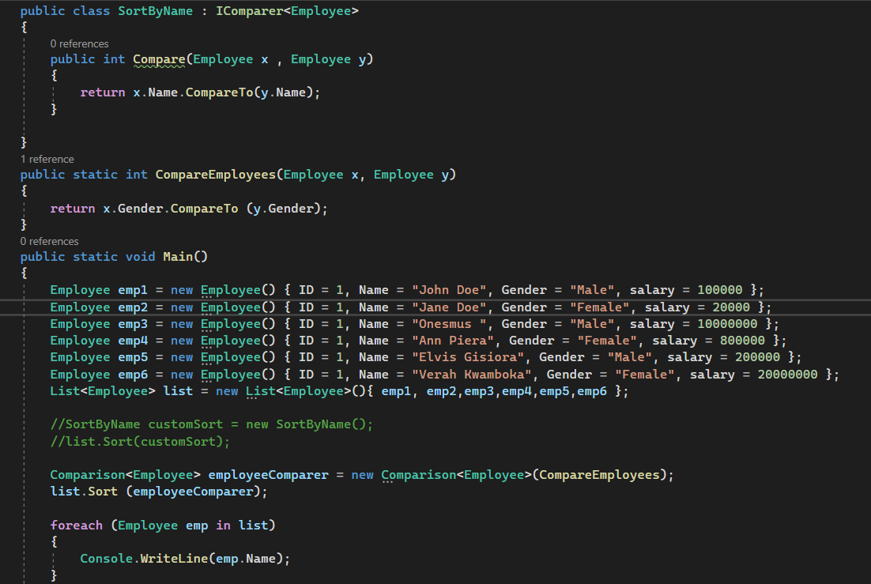
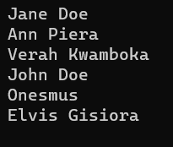

Slide 36
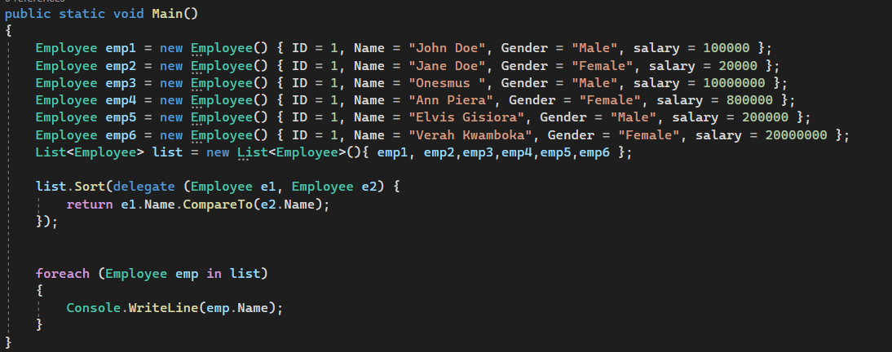
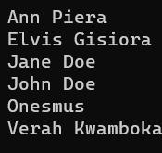

Slide 37
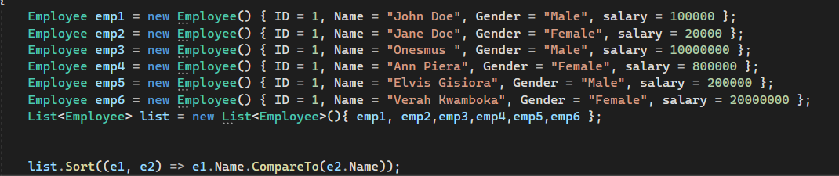
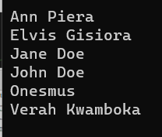
Comparison Delegate with Lambda Expression
listEmployees.Sort((e1, e2) => e1.Name.CompareTo(e2.Name));

